Slide 1
Copy Move Forgery Detection Based on Scaled ORB and K-means++
Presented By:
Mohammad Asiuzzaman ID: 1304006
Supervised By
Dr. Pranab Kumar Dhar
Professor, Department of CSE, CUET

Slide 2
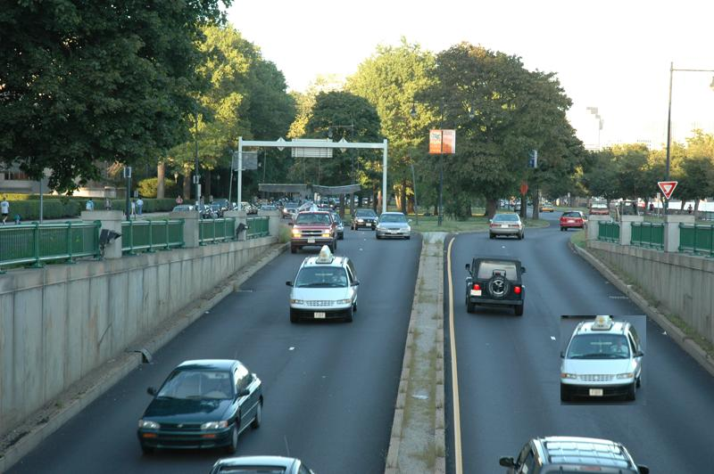
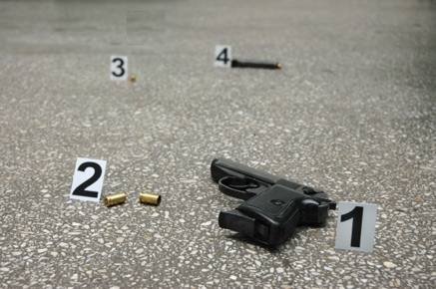
Is this real image?

Slide 3
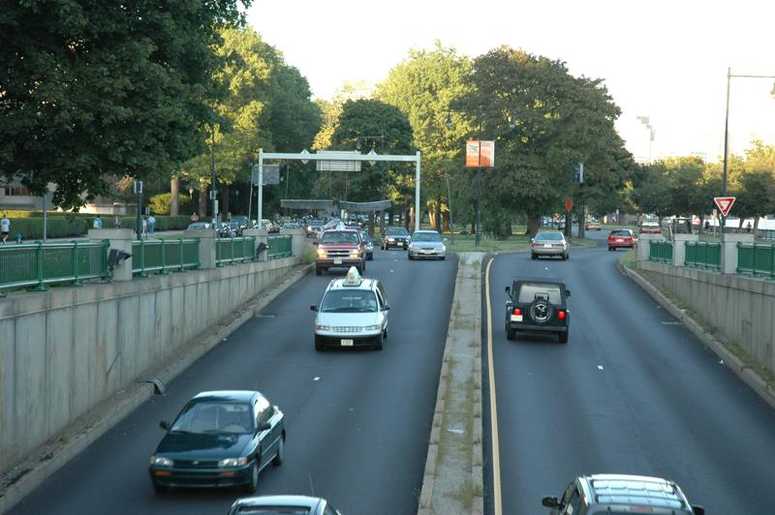
No!! This is Real

Slide 4

Copy-Move
Copy-Move Forgery

Slide 5
Contents
Introduction
Motivation
Objective
Related work
Proposed methodology
Implementation
Experimental result
Comparison
Future recommendation
References

Slide 6
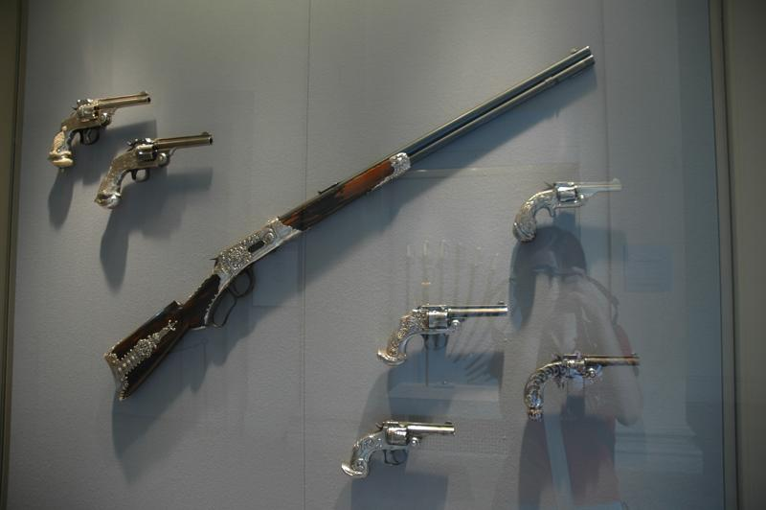
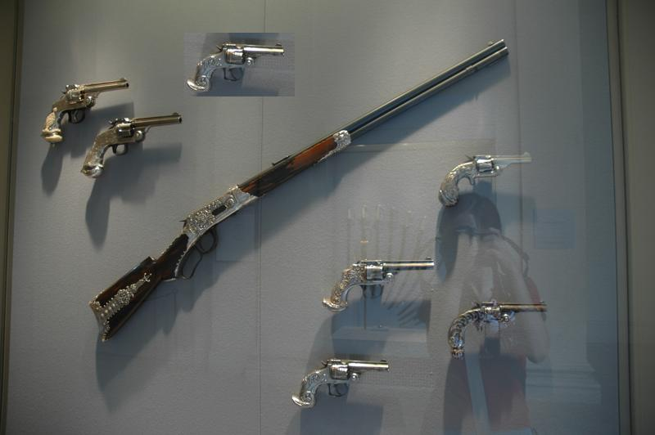
Introduction
Digital images plays an important role in our society.
Different software editing tools easily forged an image.
Since copied region pasted from the same image it is so hard to detect forgery by Human visual system.
Real image Forged image.

Slide 7
Motivation
Increased number of crimes
Publication of fake news
Decreased security
Verifying the authenticity of photo.

Slide 8
Objective
To implement copy move forgery detection.
To identify forged images.
To detect forged portions.

Slide 9
Related Work
First method had been proposed by Fridrich with the
help of DCT.
Popescu and Farid proposed a method to detect copy move forgery using PCA.
Mahadian proposed a FMT method to detect copy move forgery.

Slide 10
Related Work (Cont.)
Khan recently used DWT method to detect copy move forgery.
An efficient method used for detecting copy move forgery using DWT and FWHT.

Slide 11
System Architecture
Input image
Convert RGB to gray scale
Identify the pyramid scale space
Extract the scale ORB feature
Applying K-means++
Matching Feature
Output Image.

Slide 12
Proposed Methodology
Step 1. Input Image.
Step 2. Identify the pyramid scale space.
Step 3. Extract scale ORB feature.
3.1. Extract the FAST key points
3.2. Compute Orientation.
3.3. Build the rBRIEF feature.
Step 4. Applying k-means++ Algorithm
Step 5. Matching feature.
Step 6. Detection Result

Slide 13
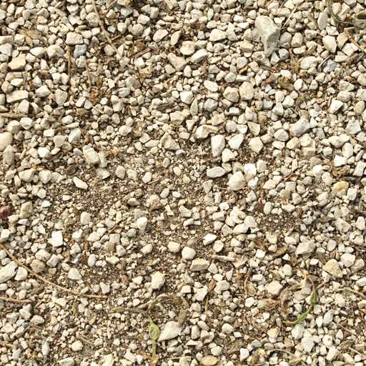
Propose Methodology(cont.)
Input Image:

Slide 14
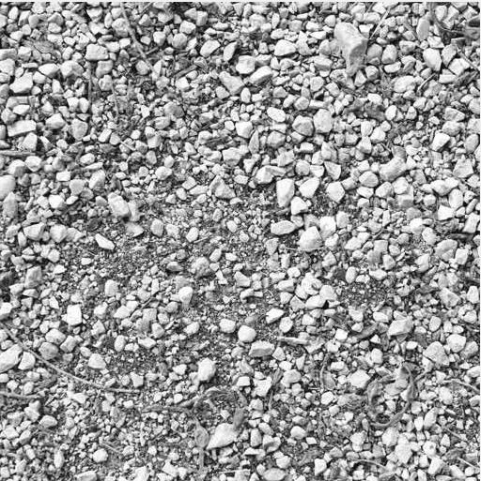
Proposed Methodology(cont.)
RGB to gray conversion

Slide 15
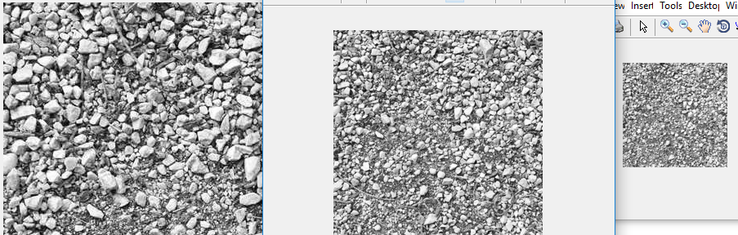
Proposed Methodology(cont.)
Identify the pyramid Scale space

Slide 16
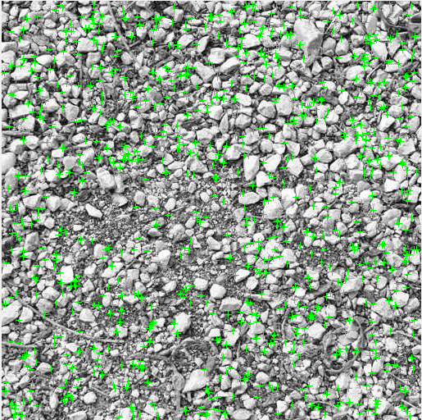
Proposed Methodology(cont.)
3.Extract ORB feature
3.1Extract the FAST key points

Slide 17
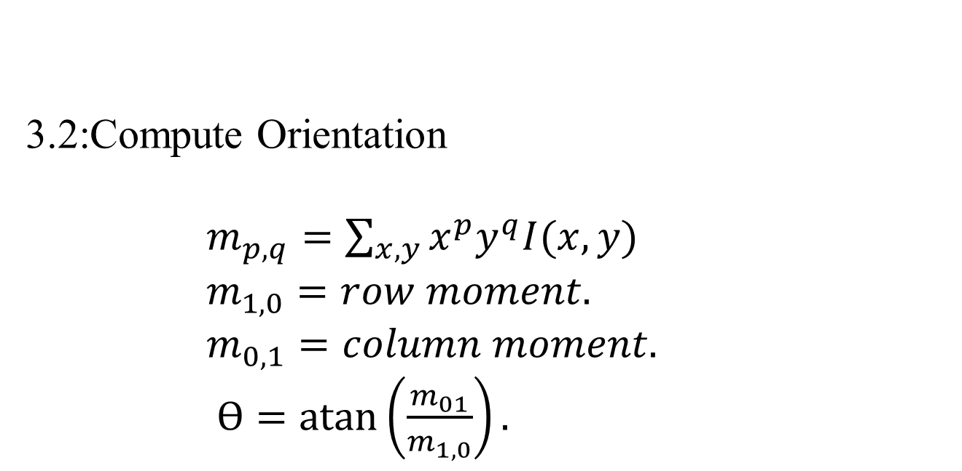
Proposed Methodology (Cont.)
.
3.2:Compute Orientation
$m_{p,q}=\sum_{x,y}{x^{p}y^{q}I(x,y)}$
$m_{1,0}=row moment.$
$m_{0,1}=column moment.$
$Ө=\operatorname{atan}\left(\frac{m_{01}}{m_{1,0}}\right).$

Slide 18
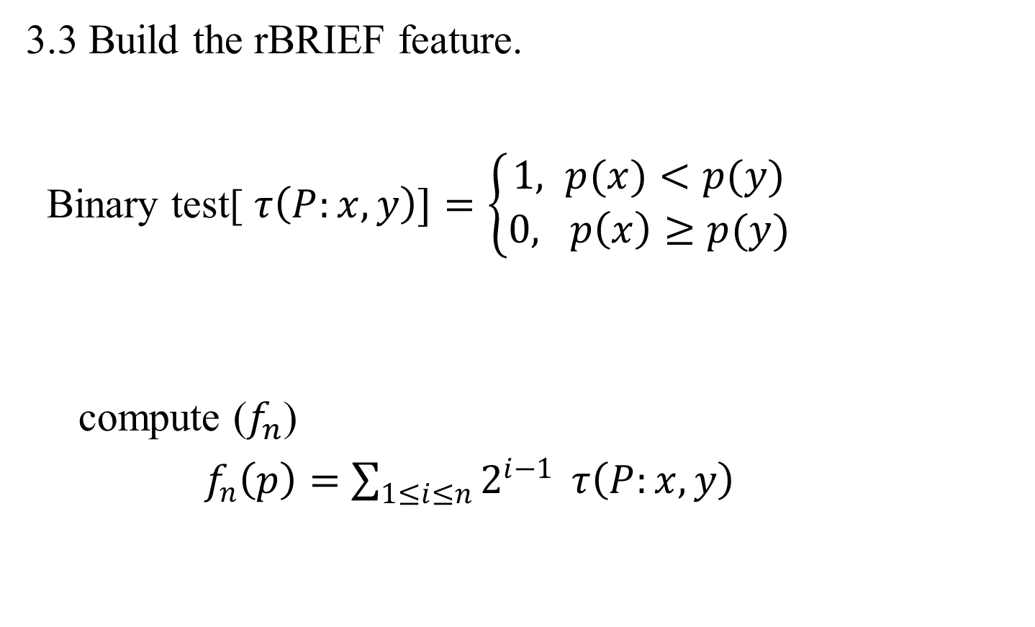
Proposed Methodology (Cont.)
3.3 Build the rBRIEF feature.
Binary test[ $τ\left(P:x,y\right)]=\left\{\begin{aligned}1, p(x)<p(y) \\ 0, p\left(x\right)≥p(y)\end{aligned}\right.$
compute ($f_{n}$)
$f_{n}\left(p\right)=$ $\sum_{1≤i≤n}{2^{i−1}} τ\left(P:x,y\right)$

Slide 19
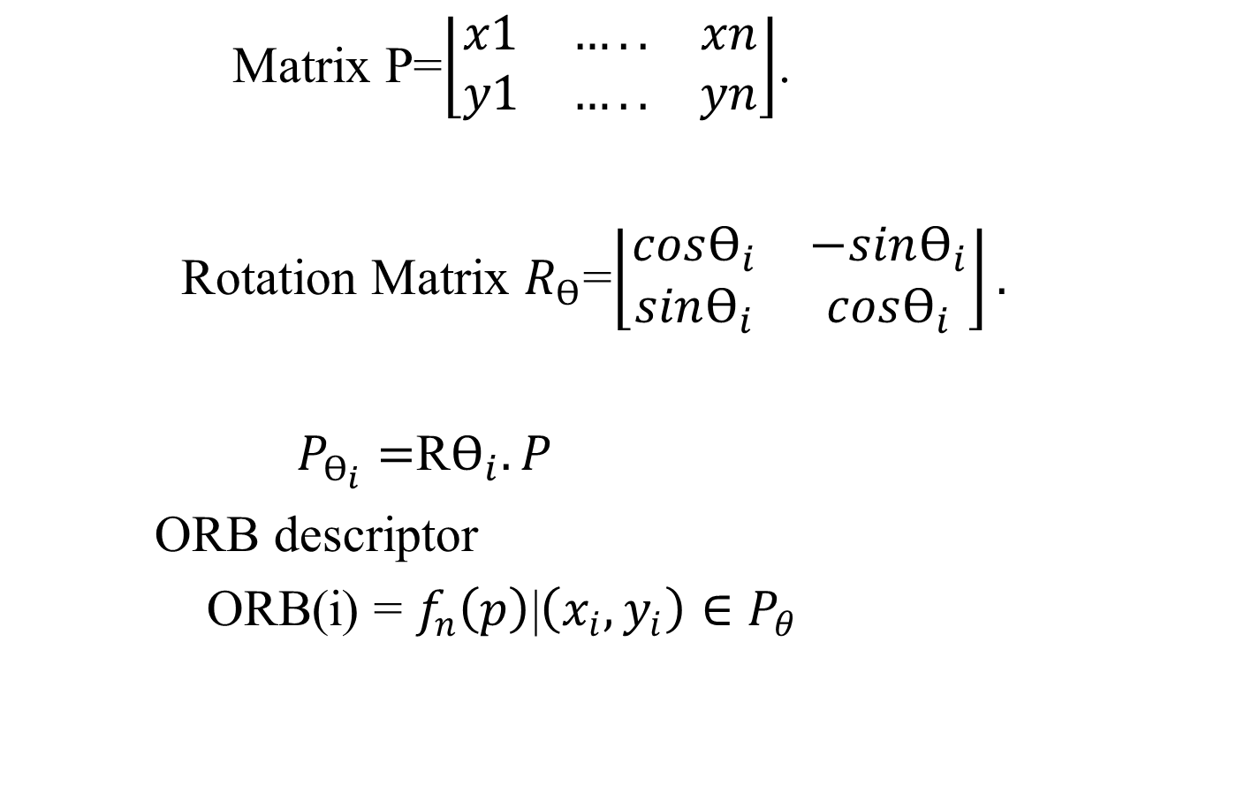
Proposed Methodology(cont.)
Matrix P=$\left\lfloor \begin{matrix}x1 & ….. & xn \\ y1 & ….. & yn\end{matrix}\right\rfloor$.
Rotation Matrix $R_{Ө}$=$\left\lfloor \begin{matrix}cosӨ_{i} & −sinӨ_{i} \\ sinӨ_{i} & cosӨ_{i}\end{matrix}\right\rfloor .$
$P_{Ө_{i}}=$R$Ө_{i}.P$
ORB descriptor
ORB(i) = $f_{n}\left(p\right)$|$\left(x_{i},y_{i}\right)∈P_{θ}$

Slide 20
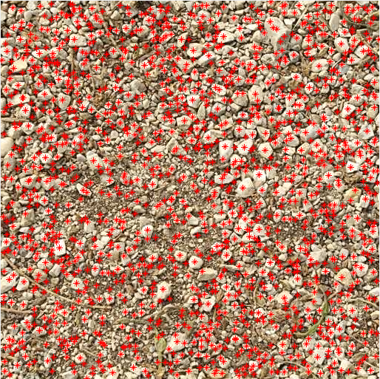
Proposed Methodology(cont.)
ORB descriptors:

Slide 21
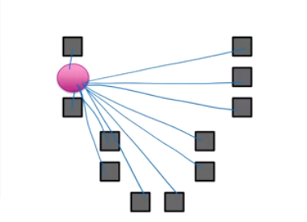
Proposed Methodology (Cont.)
4. K-means++ algorithm.

Slide 22
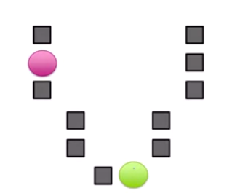
Proposed Methodology(cont.)
4.K-means ++ algorithm.

Slide 23
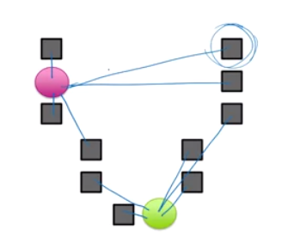
Proposed Methodology(cont.)
4.K-means++ algorithm.

Slide 24
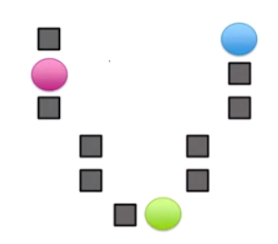
Proposed Methodology(cont.)
4.K-means++ algorithm

Slide 25
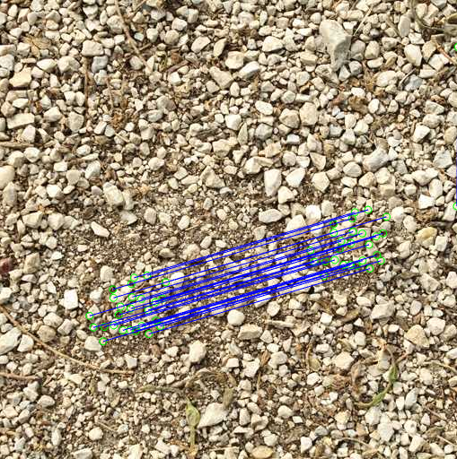
Proposed Methodology(Cont.)
Feature Matching:

Slide 26
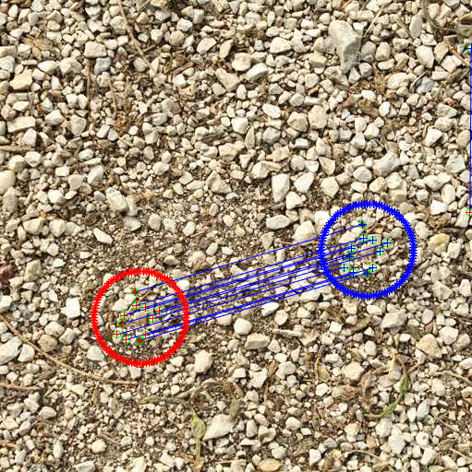
Proposed Methodology(cont.)
Detection Result

Slide 27
Experimental Result(Cont)
Input Image

Slide 28
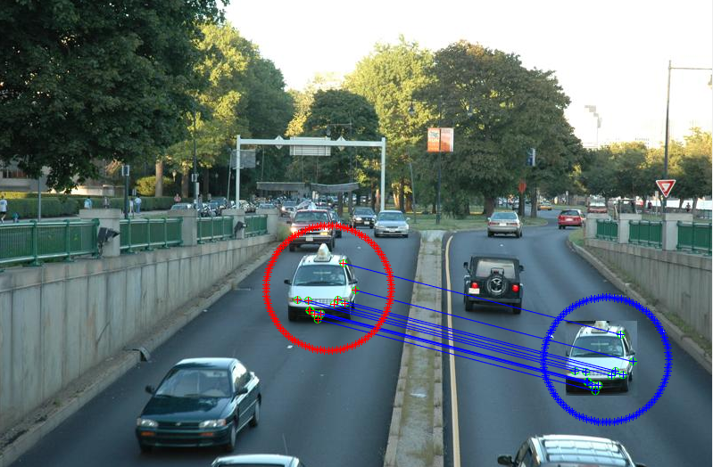
Experimental Result(Cont)
Output Image

Slide 29
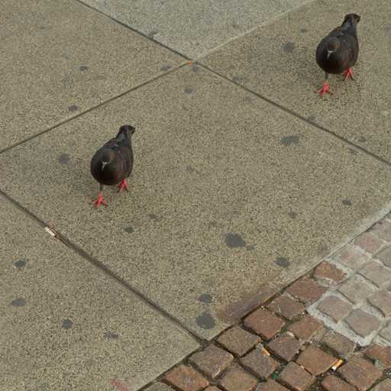
Experimental Result(Cont)
Input Image

Slide 30
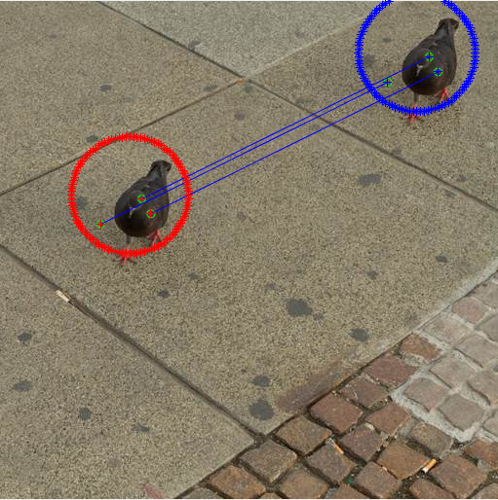
Experimental Result(Cont)
Output Image

Slide 31
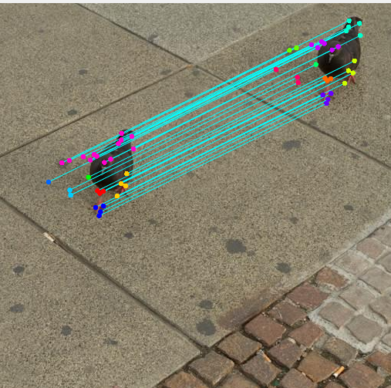
Comparison
Comparison with a method based on SIFT feature:
Proposed method SIFT feature-base method

Slide 32
Comparison(Cont)
Result Comparison
calculation of 15 forged images.
Method | Total no of matched key points | Total running Time(sec) | Total False match
SIFT Feature | 3589 | 73.3386 | 246
Proposed Method | 1553 | 13.25 | 104

Slide 33
Future Recommendation
Applying extra post processing on the forged image, then detect the tempered region.
Can extract more feature within a shortest possible time
and detect the forged region more precisely.

Slide 34
References
[1] n an Iranian image, a missile too many. [Online] Cited 2012-08-23. Available at: http://thelede.blogs.nytimes.com/2008/07/10/inan-iranian-image-a-missile-too-many/
[2] FRIDRICH, J., SOUKAL, D., LUKAS, J. Detection of copy move forgery I digital images. In Proc. Digital Forensic Res.Workshop. Cleveland(USA), Aug.2003.
[3] POPESCU, A.C,FARID, H. Exposing digital forgeries by detecting traces of resampling. IEEE Transactions on signal Processing , 2005, vol. 53, no. 10, p. 758-767.
[4] BAYRAM, S., SENCAR, H. T., MEMON, N. An efficient and robust method for detecting copy-move forgery. In IEEE International Conference on Acoustics, Speech and Signal ProcessingICASSP 2009. 2009, p. 1053-1056.
[5] HUANG, Y., LU, W., SUN, W., LONG, D. Improved DCT-based detection of copy-move forgery in images. Forensic Science International, 2011, vol. 206, no. 1-3, p. 178-184.
[6] KHAN, S., KULKARNI A. An efficient method for detection of copy move forgery using Discrete Wavelet Transform. International Journal on Computer Science and Engineering,2010, vol.2, no. 5, p. 18801-1806.
[7] A copy move forgery detection method based on CMFD-SIFT Bing Yang. Xingming Sun. Honglei Guo. Zhihua Xia. Xianye Chen.
[8] n Efficient Forensic Method for Copy-Move Forgery Detection Based on DWT-FWHT.Bi YANG, XINGMING SUN, Xianyi CHEN, Jianjun ZHANG, Xu LI.
[9] XIAOYING, F., COX, I., J., DOERR, G. Normalized energy density-based forensic detection of the resampled images, IEEE Transactions on Multimedia, 2012, vol. 14, no. 3, p. 536-545.
[10] M. Vetterli and J. Kova· cevi c, Wavelets and Subband Coding,Prentice-Hall, Englewood Cli®s, NJ, 1995.

Slide 35


